Slide 1
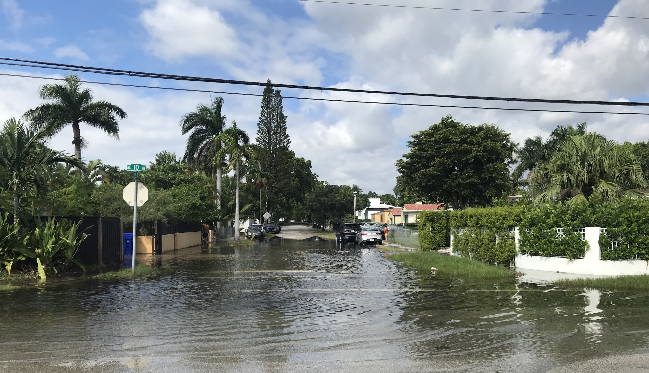
Living with more water:
exploring a local voluntary home buyout program as an adaptation strategy
Monica Gregory, MPA
Resilience Programs Coordinator
Office of Resilience - Miami-Dade County

Slide 2
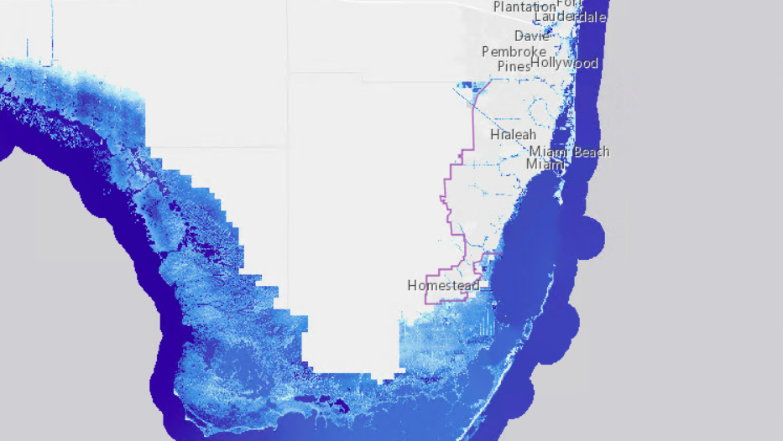
71,702
What’s the issue?
housing units exposed*
*using a national bathtub model found from Climate Central. More information found here.
Under a three-foot rise in sea level
(predicted to occur by 2070)

Slide 3
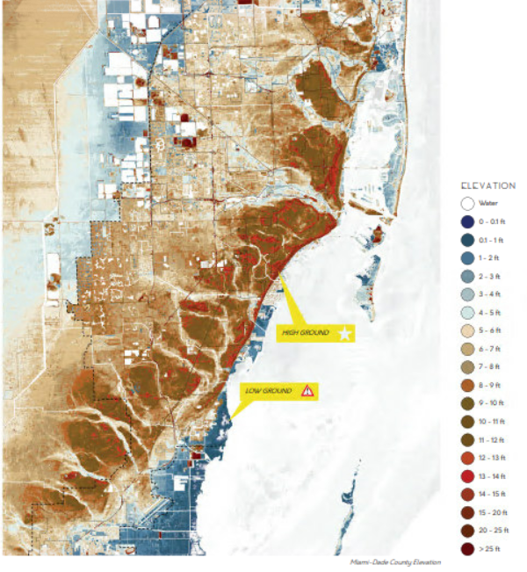





What’s the intersection between
affordable housing & sea level rise?
Potential loss of housing stock
Additional pressures in areas with naturally occurring affordable housing
Many options to adapt
(short-, medium-, & long-term)
Major issues to explore
  Paired policies
  Funding
  Redevelopment vs. open space
Elevate Buildings
Elevate on Fill
Flood-proof
Elevate
Critical Equipment
Voluntary Buy-Outs

Slide 4
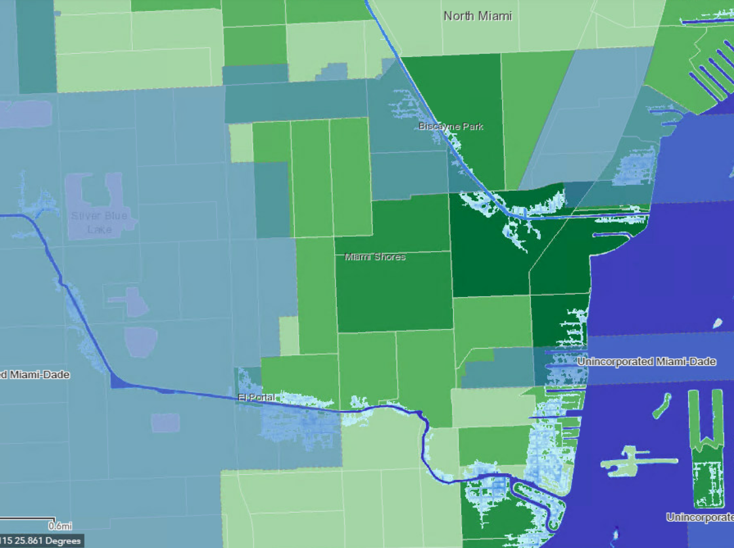
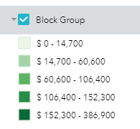
What did I learn so far?
Case Study :
Unincorporated Miami-Dade
(Little River)
Legend
= UMSA
= Average household income
Pockets of flood-prone areas in UMSA
Varied average household incomes
Household awareness and interest levels may vary
3 ft of sea rise

Slide 5
Next steps?
Listen first
  Support community conversations about voluntary buyouts in Little River
    Partner with trusted groups
    Local needs and interest
    Benefits and trade-offs
    Needed policies
Learn from others
  Compile costs, criteria for existing voluntary buyout programs in other counties and cities
Outline potential criteria
  Funding sources to sustain a local program
  Incentives for interested homeowners
  Potential policy and regulation changes
Images from ULI Panel Focus Group with
Miami-Dade County, 2017

Slide 6
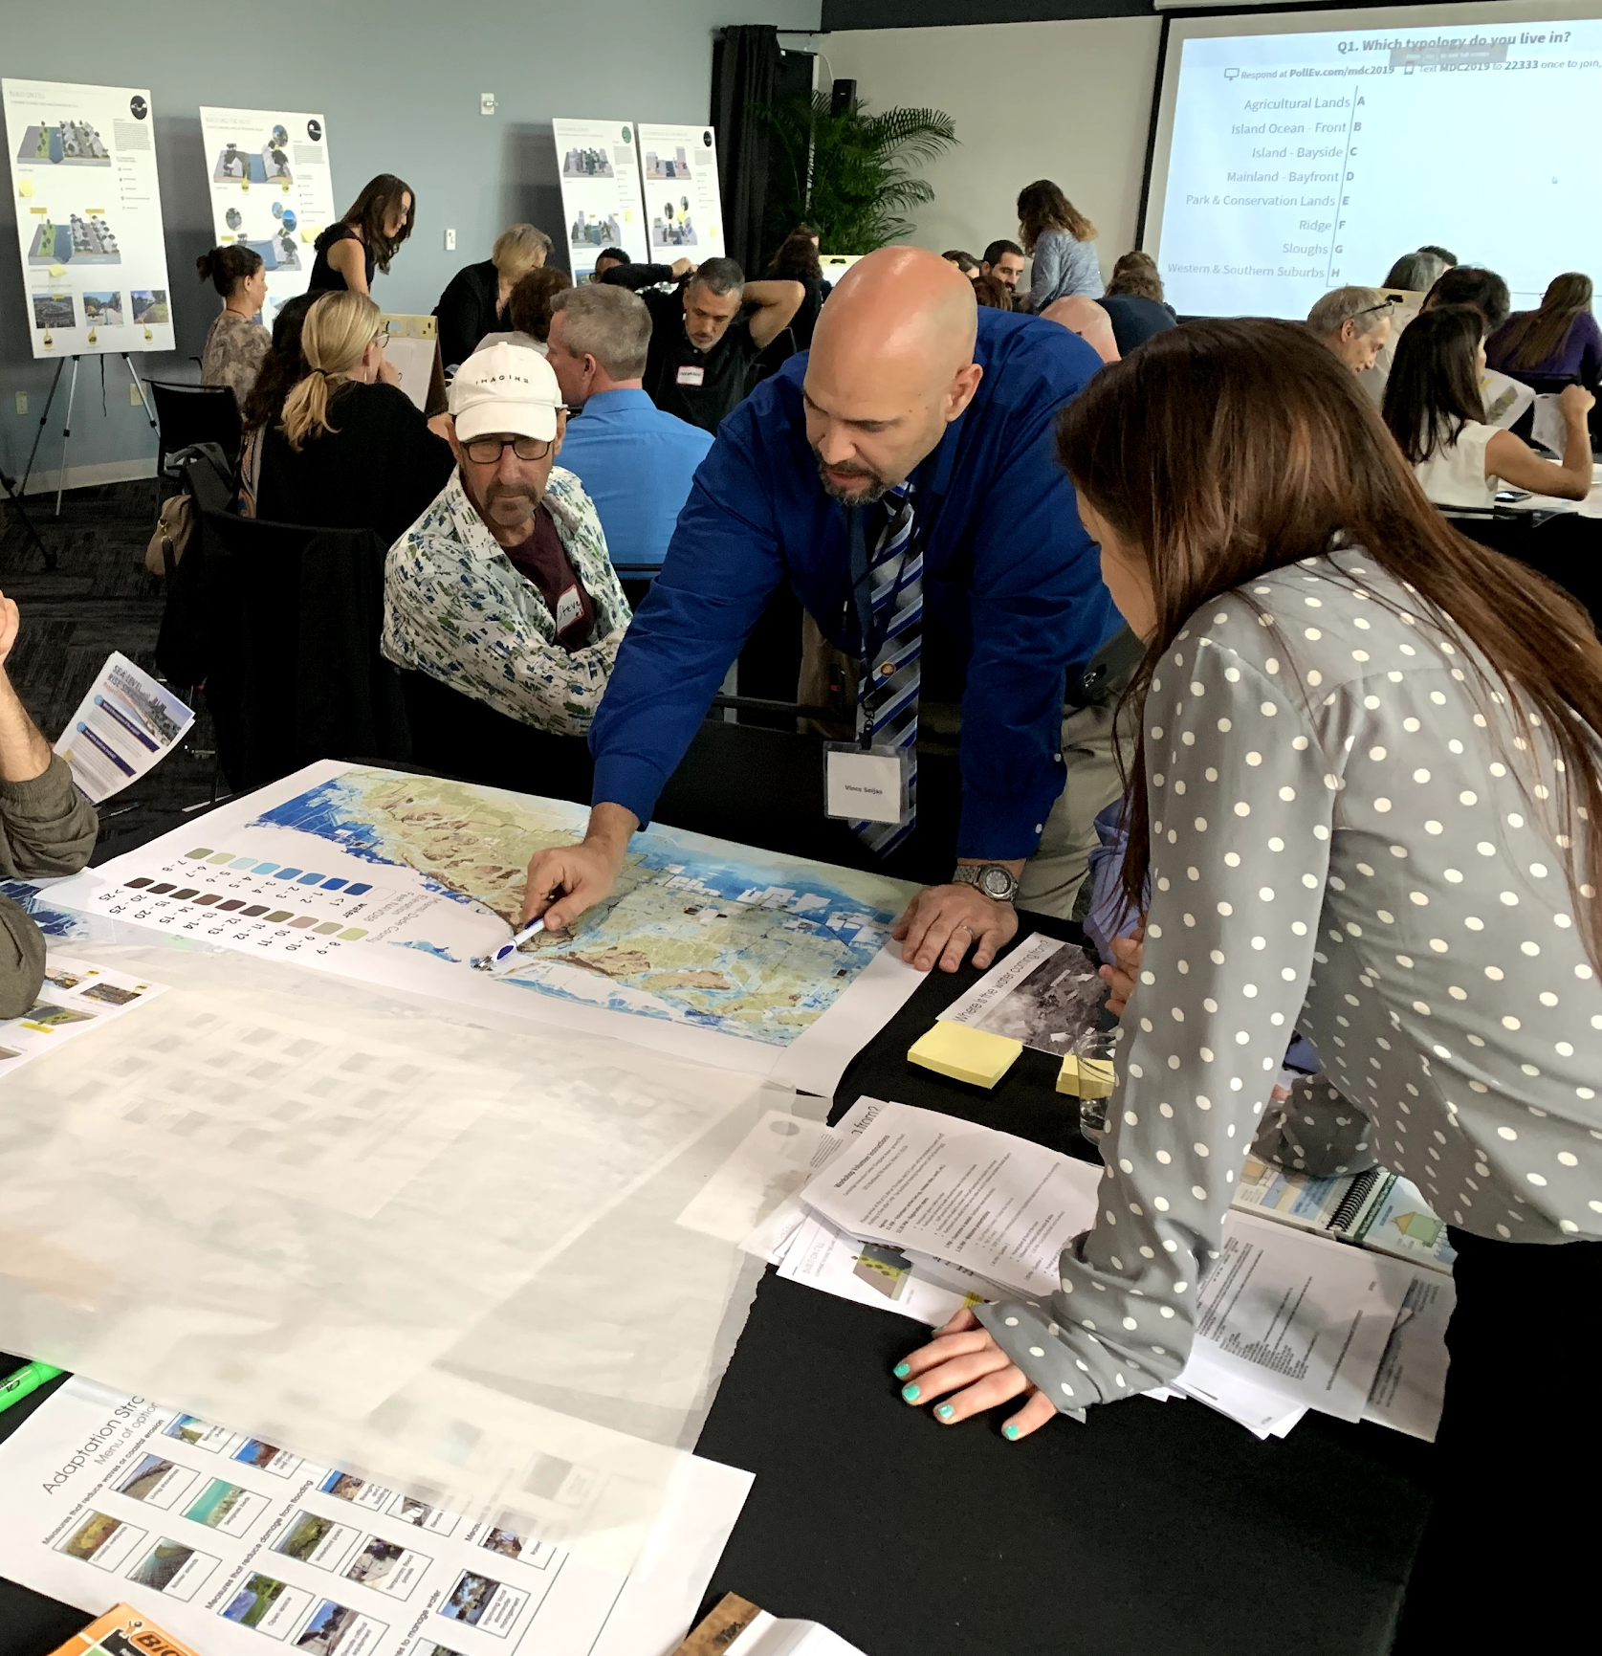
What can you do?
Engage in the wider conversation
  Participate in national webinars and facilitated virtual discussions
  Come out to County and city workshops to work with us on these issues
Partner with us
  Contact me to exchange knowledge, share ideas, and build these programs together
Make your voice heard
  Let your County and local government officials know you need
  Host neighborhood conversations about these topics

Slide 7
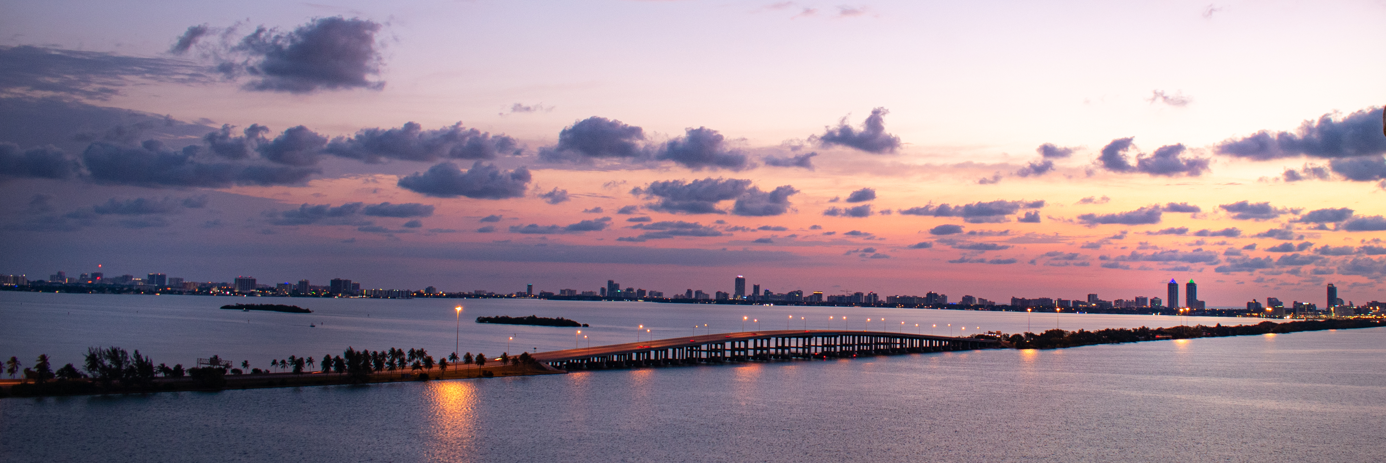
Thank you!
Contact me any time ~
Monica Gregory
Adaptation Programs Coordinator
Monica.Gregory@miamidade.gov

